Slide 1

Welcome to My Presentation
Nasif Uddin
Computer Fundamentals and Office Applications
Batch : 20

Slide 2
Company Overview
Gadget Home Ltd. is a premier technology-driven manufacturing firm based in Bangladesh. Established in 2010, the company has rapidly evolved into a key player in the electronics and consumer goods sectors, specializing in the production of high-quality electronic components, home appliances, and consumer electronics.

Slide 3
Mission and Vision
Mission: To deliver innovative and superior quality products that enhance the everyday lives of consumers while fostering sustainable growth and development.
Vision: To be a global leader in the manufacturing industry, known for our commitment to excellence, innovation, and environmental stewardship

Slide 4
Products and Services
Gadget Home Ltd. offers a diverse range of products including:
Electronic Components: Precision-engineered components for various industrial applications.
Home Appliances: High-efficiency refrigerators, washing machines, and air conditioners.
Consumer Electronics: Cutting-edge smartphones, tablets, and smart home devices.

Slide 5
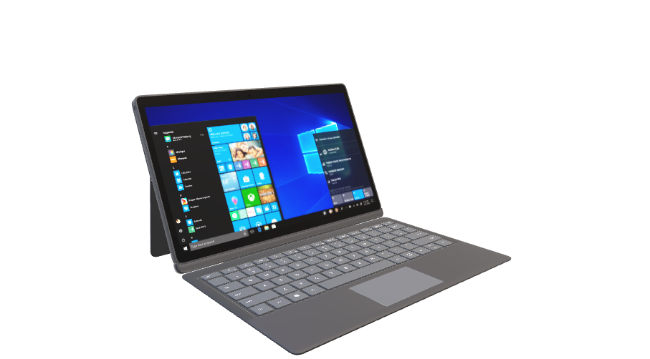
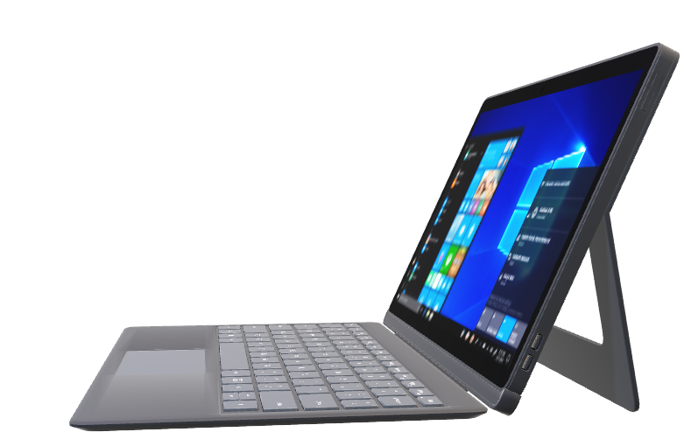
Laptops

Slide 6
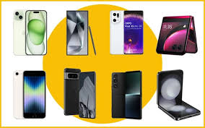
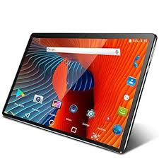
Smartphones and tablets

Slide 7
Flow Chart of Business Plan
Sales Strategy
Distribution and Logistics
Customer Service
Financial Planning
Market Research
Product Development
Production Planning
Marketing Strategy
Monitoring and Evaluation

Slide 8
Yearly report
Month | Expenses | Sales | Profit
January | 9288500 | 8750000 | -538500
February | 9744300 | 9920000 | 175700
March | 8904700 | 10000000 | 1095300
April | 7345200 | 7957400 | 612200
May | 8987000 | 9876500 | 889500
June | 5215400 | 5164500 | -50900
July | 9976500 | 11543600 | 1567100
August | 7976700 | 8087900 | 111200
September | 9879000 | 9969800 | 90800
October | 6234800 | 7024000 | 789200
November | 4534800 | 4809300 | 274500
December | 8348700 | 8834800 | 486100

Slide 10
THANK YOU

